Slide 1
Mining Frequent Patterns without Candidate Generation
Jiawei Han, Jian Pei and Yiwen Yin
SIGMOD 2000’ Conference
Presented By:
Xun Luo and Shun Liang
04/07/2005

Slide 2
Outline
Introduction
Constructing FP-Tree
  Example 1
Mining Frequent Patterns using FP-Tree
  Example 2
Performance Evaluation
Discussions

Slide 3
Introduction
Terminology
Apriori-like Algorithms
  Generate-and-Test
  Cost Bottleneck
FP-Tree and FP-Growth Algorithm
  FP-Tree: Frequent Pattern Tree
  FP-Growth: Mining frequent patterns with FP-Tree

Slide 4
Terminology
Item set
  A set of items: I = {a₁, a₂, ……, a_{m}}
Transaction database
  DB = <T₁, T₂, ……, T_{n}>
Pattern
  A set of items: A
Support
  The number of transactions containing A in DB
Frequent pattern
  A’s support ≥ minimum support threshold ξ
Frequent Pattern Mining Problem
  The problem of finding the complete set of frequent patterns

Slide 5
Apriori-like Algorithms
Algorithm
  Anti-Monotone Heuristic
    If any length k pattern is not in the database, its length (k+1) super-pattern can never be frequent
  Generating candidate set
  Testing candidate set
Two non-trivial costs: (Bottleneck)
  Candidate sets are huge. (They are pruned already but still increase exponentially with stage number k).
  Repeated scan the database and test the candidate set by pattern matching.

Slide 6
FP-Tree and FP-Growth Algorithm
FP-Tree: Frequent Pattern Tree
  Compact presentation of the DB without information loss.
  Easy to traverse, can quickly find out patterns associated with a certain item.
  Well-ordered by item frequency.
FP-Growth Algorithm
  Start mining from length-1 patterns
  Recursively do the following
    Constructs its conditional FP-tree
    Concatenate patterns from conditional FP-tree with suffix
  Divide-and-Conquer mining technique

Slide 7
Outline
Introduction
Constructing FP-Tree
  Example 1
Mining Frequent Patterns using FP-Tree
  Example 2
Performance Evaluation
Discussions

Slide 8
FP-Tree Definition
Three components:
  One root: labeled as “null”
  A set of item prefix subtrees
  A frequent-item header table
root
f : 4
c : 1
c : 3
b : 1
b : 1
Header Table
a : 3
p : 1
item
head of node-links
f
m : 2
b : 1
c
a
b
p : 2
m : 1
m
p

Slide 9
FP-Tree Definition (cont.)
Each node in the item prefix subtree consists of three fields:
  item-name
  node-link
  count
Each entry in the frequent-item header table consists of two fields:
  item-name
  head of node-link

Slide 10
Example 1: FP-Tree Construction
The transaction database used (fist two column only):
minimum support threshold ξ= 3
TID | Items Bought | (Ordered) Frequent Items
100 | f,a,c,d,g,i,m,p | f,c,a,m,p
200 | a,b,c,f,l,m,o | f,c,a,b,m
300 | b,f,h,j,o | f,b
400 | b,c,k,s,p | c,b,p
500 | a,f,c,e,l,p,m,n | f,c,a,m,p

Slide 11
Example 1 (cont.)
First Scan: //count and sort
  count the frequencies of each item
  collect length-1 frequent items, then sort them in support descending order into L, frequent item list.
  L = {(f:4), (c:4), (a:3), (b:3), (m:3), (p:3)}

Slide 12
Example 1 (cont.)
Second Scan://create the tree and header table
  create the root, label it as “null”
  for each transaction Trans, do
    select and sort the frequent items in Trans
    increase nodes count or create new nodes
    If prefix nodes already exist, increase their counts by 1;
    If no prefix nodes, create it and set count to 1.
  build the item header table
    nodes with the same item-name are linked in sequence via node-links

Slide 13
Example 1 (cont.)
The building process of the tree
root
root
root
root
f : 1
f : 2
f : 3
c : 1
c : 2
c : 2
b : 1
a : 1
a : 2
a : 2
m : 1
m : 1
b : 1
m : 1
b : 1
p : 1
p : 1
m : 1
p : 1
m : 1
Create root
After trans 1 (f,c,a,m,p)
After trans 2 (f,c,a,b,m)
After trans 3 (f,b)

Slide 14
Example 1 (cont.)
The building process of the tree (cont.)
root
root
f : 3
c : 1
f : 4
c : 1
c : 2
b : 1
b : 1
c : 3
b : 1
b : 1
a : 2
p : 1
a : 3
p : 1
m : 1
b : 1
m : 2
b : 1
p : 1
m : 1
p : 2
m : 1
After trans 4 (c,b,p)
After trans 5 (f,c,a,m,p)

Slide 15
Example 1 (cont.)
Build the item header table
root
f : 4
c : 1
c : 3
b : 1
b : 1
Header Table
a : 3
p : 1
item
head of node-links
f
m : 2
b : 1
c
a
b
p : 2
m : 1
m
p

Slide 16
FP-Tree Properties
Completeness
  Each transaction that contains frequent pattern is mapped to a path.
  Prefix sharing does not cause path ambiguity, as only path starts from root represents a transaction.
Compactness
  Number of nodes bounded by overall occurrence of frequent items.
  Height of tree bounded by maximal number of frequent items in any transaction.

Slide 17
FP-Tree Properties (cont.)
Traversal Friendly (for mining task)
  For any frequent item a_{i}, all the possible frequent patterns that contain a_{i} can be obtained by following a_{i}’s node-links.
  This property is important for divide-and-conquer. It assures the soundness and completeness of problem reduction.

Slide 18
Outline
Introduction
Constructing FP-Tree
  Example 1
Mining Frequent Patterns using FP-Tree
  Example 2
Performance Evaluation
Discussions

Slide 19
FP-Growth Algorithm
Functionality:
  Mining frequent patterns using FP-Tree generated before
Input:
  FP-tree constructed earlier
  minimum support threshold ξ
Output:
  The complete set of frequent patterns
Main algorithm:
  Call FP-growth(FP-tree, null)

Slide 20
FP-growth(Tree, α)
Procedure FP-growth(Tree, α)
{
if (Tree contains only a single path P)
{ for each combination β of the nodes in P
{ generate pattern β Uα;
support = min(sup of all nodes in β)
}
}
else // Tree contains more than one path
{ for each a_{i} in the header of Tree
{ generate pattern β= a_{i} Uα;
β.support = a_{i}.support;
construct β’s conditional pattern base;
construct β’s conditional FP-tree Tree_{β};
if (Tree_{β} ≠ Φ)
FP-growth(Tree_{β} , β);
}
}
}

Slide 21
Example 2
Start from the bottom of the header table: node p
Two paths
p’s conditional pattern base
  {(f:2, c:2, a:2, m:2), (c:1, b:1)}
p’s conditional FP-tree
  Only one branch (c:3)
➔pattern (cp:3)
Patterns:
  (p:3)
  (cp:3)
transformed prefix path
root
f : 4
c : 1
c : 3
b : 1
b : 1
Header Table
a : 3
p : 1
item
head of node-links
f
m : 2
b : 1
c
a
b
p : 2
m : 1
m
p

Slide 22
Example 2 (cont.)
Continue with node m
Two paths
m’s conditional pattern base
  {(f:2, c:2, a:2), (f:1,c:1, a:1, b:1)}
m’s conditional FP-tree:
  (f:3, c:3, a:3)
Call mine(<f:3, c:3, a:3>| m)
Patterns:
  (m:3)
  see next slide
root
f : 4
c : 1
c : 3
b : 1
b : 1
Header Table
a : 3
p : 1
item
head of node-links
f
m : 2
b : 1
c
a
b
p : 2
m : 1
m
p

Slide 23
mine(<(f:3, c:3, a:3>| m)
root
node a:
  (am:3)
  call mine(<f:3, c:3>|am)
    (cam:3)
    call(<f:3)|cam)
      (fcam:3)
    (fam:3)
node c:
  (cm:3)
  call mine(<f:3>|cm)
    (fcm:3)
node f:
  (fm:3)
All the patterns: (m:3, am:3, cm:3, fm:3, cam:3, fam:3, fcm:3, fcam:3)
Conclusion: A single path FP-Tree can be mined by outputting all the combination of the items in the path.
Header Table
item
head of node-links
f : 3
f
c
a
c : 3
a : 3
conditional FP-tree of “m”

Slide 24
Example 2 (cont.)
Continue with node b
Three paths
b’s conditional pattern base
  {(f:1, c:1, a:1), (f:1), (c:1)}
b’s conditional FP-tree
  Φ
Patterns:
  (b:3)
root
f : 4
c : 1
c : 3
b : 1
b : 1
Header Table
a : 3
p : 1
item
head of node-links
f
m : 2
b : 1
c
a
b
p : 2
m : 1
m
p

Slide 25
Example 2 (cont.)
Continue with node a
One path
a’s conditional pattern base
  {(f:3, c:3)}
a’s conditional FP-tree
  {(f:3, c:3)}
Patterns:
  (a:3)
  (ca:3)
  (fa:3)
  (fca:3)
root
f : 4
c : 1
c : 3
b : 1
b : 1
Header Table
a : 3
p : 1
item
head of node-links
f
m : 2
b : 1
c
a
b
p : 2
m : 1
m
p

Slide 26
Example 2 (cont.)
Continue with node c
Two paths
c’s conditional pattern base
  {(f:3)}
c’s conditional FP-tree
  {(f:3)}
Patterns:
  (c:4)
  (fc:3)
root
f : 4
c : 1
c : 3
b : 1
b : 1
Header Table
a : 3
p : 1
item
head of node-links
f
m : 2
b : 1
c
a
b
p : 2
m : 1
m
p

Slide 27
Example 2 (cont.)
Continue with node f
One path
f’s conditional pattern base
  Φ
f’s conditional FP-tree
  Φ
Patterns:
  (f:4)
root
f : 4
c : 1
c : 3
b : 1
b : 1
Header Table
a : 3
p : 1
item
head of node-links
f
m : 2
b : 1
c
a
b
p : 2
m : 1
m
p

Slide 28
Example 2 (cont.)
Final results:
item | conditional pattern base | conditional FP-tree
p | {(f:2, c:2, a:2, m:2), (c:1, b:1)} | {(c:3)}| p
m | {(f:4, c:3, a:3, m:2), (f:4, c:3, a:3, b:1, m:1)} | {(f:3, c:3, a:3)}| m
b | {(f:4, c:3, a:3, b:1), (f:4, b:1), (c:1, b:1)} | Φ
a | {(f;3, c:3)} | {(f:3, c:3}| a
c | {(f:3)} | {(f:3)}| c
f | Φ | Φ

Slide 29
FP-Growth Properties
Property 3.2 : Prefix path property
  To calculate the frequent patterns for a node a_{i} in a path P, only the prefix subpath of node a_{i} in P need to be accumulated, and the frequency count of every node in the prefix path should carry the same count as node a_{i}.
Lemma 3.1 : Fragment growth
  Letαbe an itemset in DB, B beα's conditional pattern base, and βbe an itemset in B. Then the support ofαUβin DB is equivalent to the support of βin B.

Slide 30
FP-Growth Properties (cont.)
Corollary 3.1 (Pattern growth)
  Let αbe a frequent itemset in DB, B be α's conditional pattern base, and βbe an itemset in B. Then αUβis frequent in DB if and only if is βfrequent in B.
Lemma 3.2 (Single FP-tree path pattern generation)
  Suppose an FP-tree T has a single path P. The complete set of the frequent patterns of T can be generated by the enumeration of all the combinations of the subpaths of P with the support being the minimum support of the items contained in the subpath.

Slide 31
Outline
Introduction
Constructing FP-Tree
  Example 1
Mining Frequent Patterns using FP-Tree
  Example 2
Performance Evaluation
Discussions

Slide 32
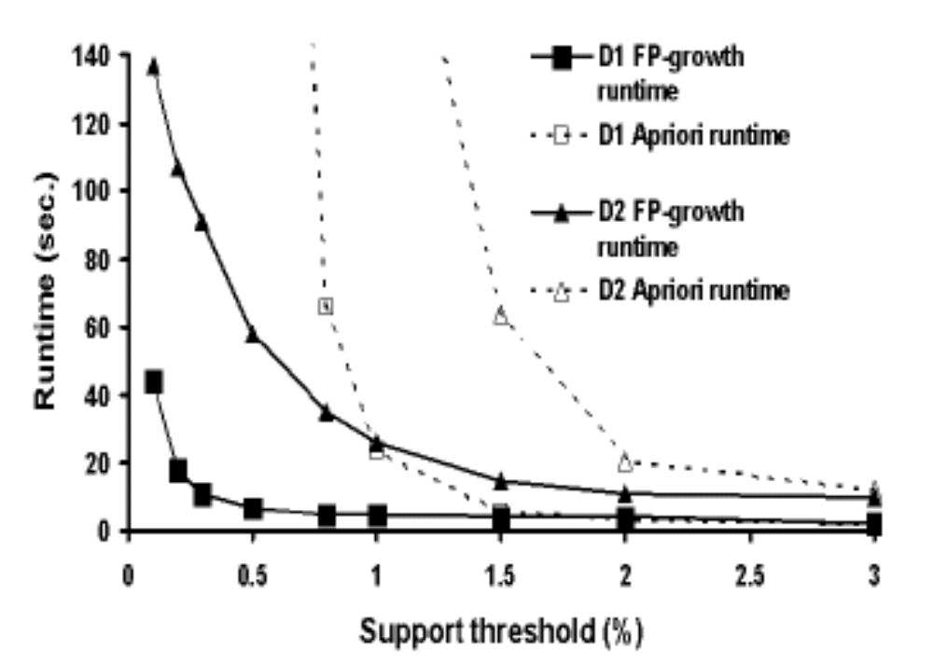
Performance Evaluation:
FP-Tree vs. Apriori
Scalability with Support Threshold

Slide 33
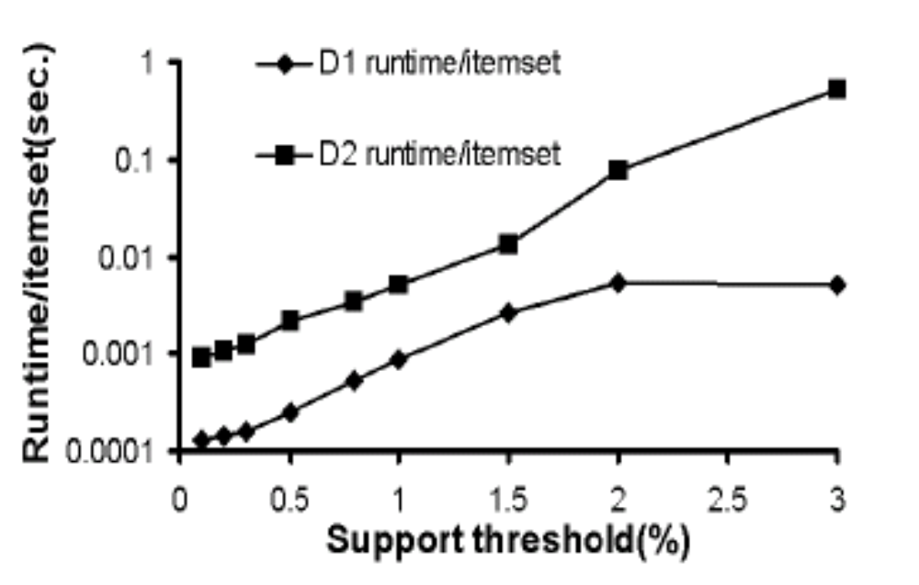
Performance Evaluation:
FP-Tree vs. Apriori (Cont.)
Per-item runtime actually decreases with support threshold decrease.

Slide 34
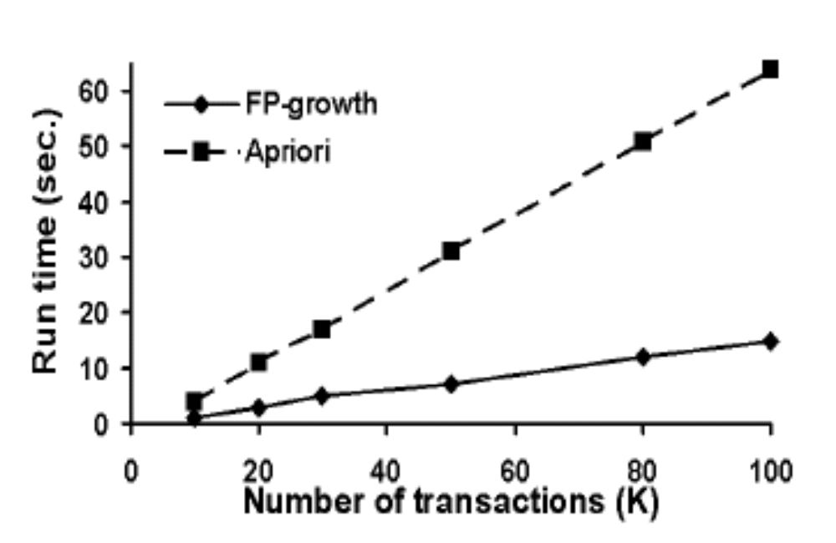
Performance Evaluation:
FP-Tree vs. Apriori (Cont.)
Scalability with DB size.

Slide 35
Outline
Introduction
Constructing FP-Tree
  Example 1
Mining Frequent Patterns using FP-Tree
  Example 2
Performance Evaluation
Discussions

Slide 36
Discussions
When database is extremely large.
  Use FP-Tree on projected databases.
  Or, make FP-Tree disk-resident.
Materialization of an FP-Tree
  Construct it independently of queries, with an reasonably fit-majority minimum support-threshold.
Incremental updates of an FP-Tree.
  Record frequency count for every item.
  Control by watermark.

Slide 37

Thank you!
Q & A.

